Slide 1
How to Speak https://www.youtube.com/watch?v=Unzc731iCUY
Kenneth Church
CS 7290

Slide 2
Say everything three times
Say what you will say
Say it
Say what you said
Promise
Connect the dots: 1 → 3
Delivery

Slide 3
The Promise
Success in life depends on ability to communicate
Ability to speak
Ability to write
Quality of ideas
(In that order)
Here is my promise:
Today you will see some examples
It may be that only one of these is the one that gets you the job

Slide 4
Outline
How to start
Joke? No!
Promise? Yes!
Samples/heuristics
Rule of 3s (cycle)
Build a fence around your idea
Distinguish from others
Verbal Punctuation (8 min)
Ask a question (example of above)
Time: 11A (audience is awake)
Place: not dark, cased, populated (12 min)
Black board >> Powerpoint
Speed, target
Avoid social insults (16 min)
hands in pockets
Props: (20 min)
book → stove
bike wheel (freshman physics)

Slide 5
Outline (continued)
Empathy
Slides
Avoid too many slides/words
Don’t read slides
Slides shouldn’t upstage speaker
We have just one lang processor
Pointer (breaks prop)
Laser pointer breaks eye contact
Exactly 1 complicated slide
Keep the audience engaged
Informing
Promise
Inspiration (demos)
How to think (stories)
Persuading
Oral Exams
Job Talks (44 min)
Getting Famous

Slide 6
Outline (continued)
Job Talk
Vision: problem / approach
Done something:
steps → contributions
How much time? 5 min!
Getting Famous (55 min)
Example of sitting next to Julia Child: you never get used to being ignored
Memorable: arch learning (prop)
Slogan: one-shot learning
Surprise: one example
Not a million
Saliant idea (near miss)
Tell a story

Slide 7
How to stop (53 min)
Bad ways
Thank your collaborators
Ask for questions
URL (for more)
THE END
Conclusions
Thank you (weak move)
Better
Contributions
Tell a joke (Doug Lenat)
Salute the audience (60 min)

Slide 8
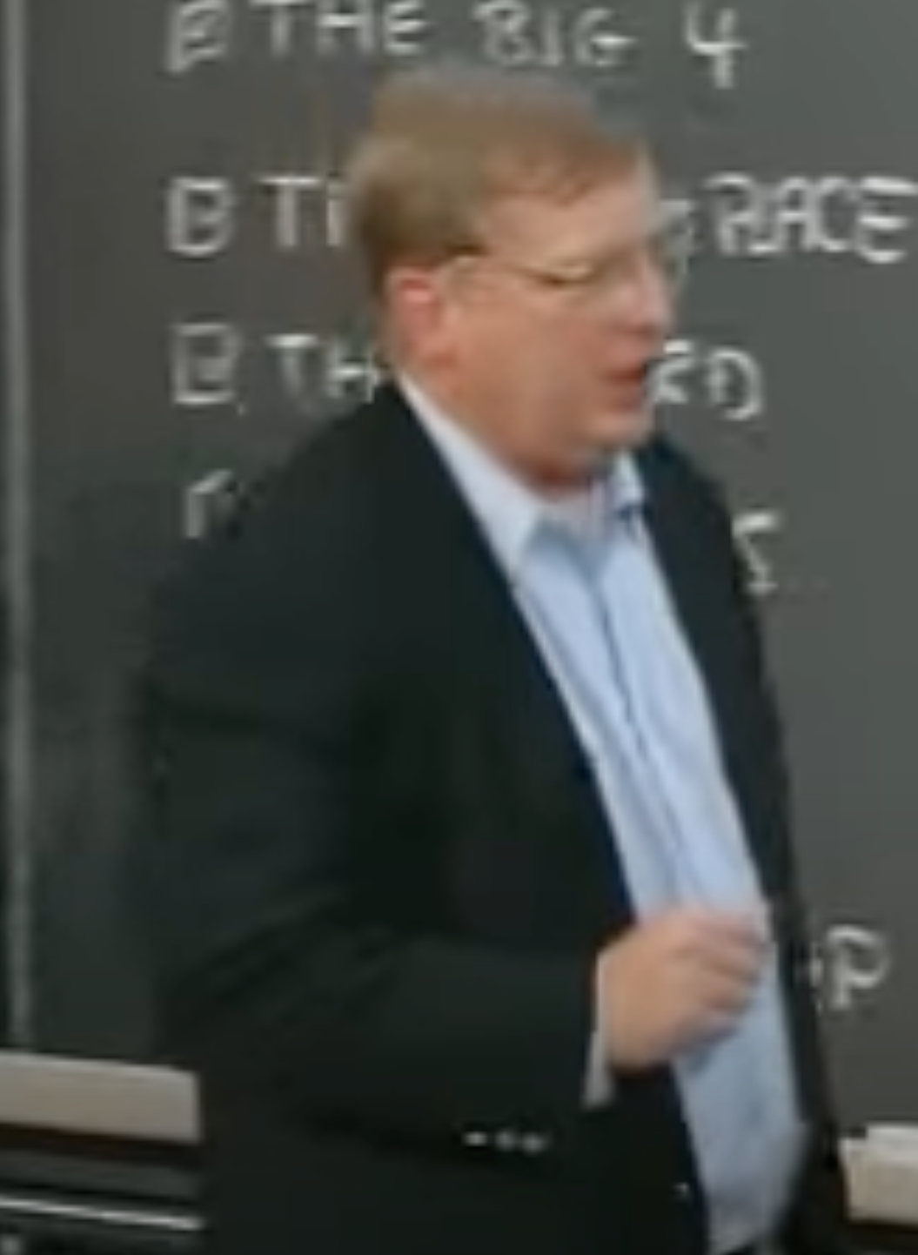
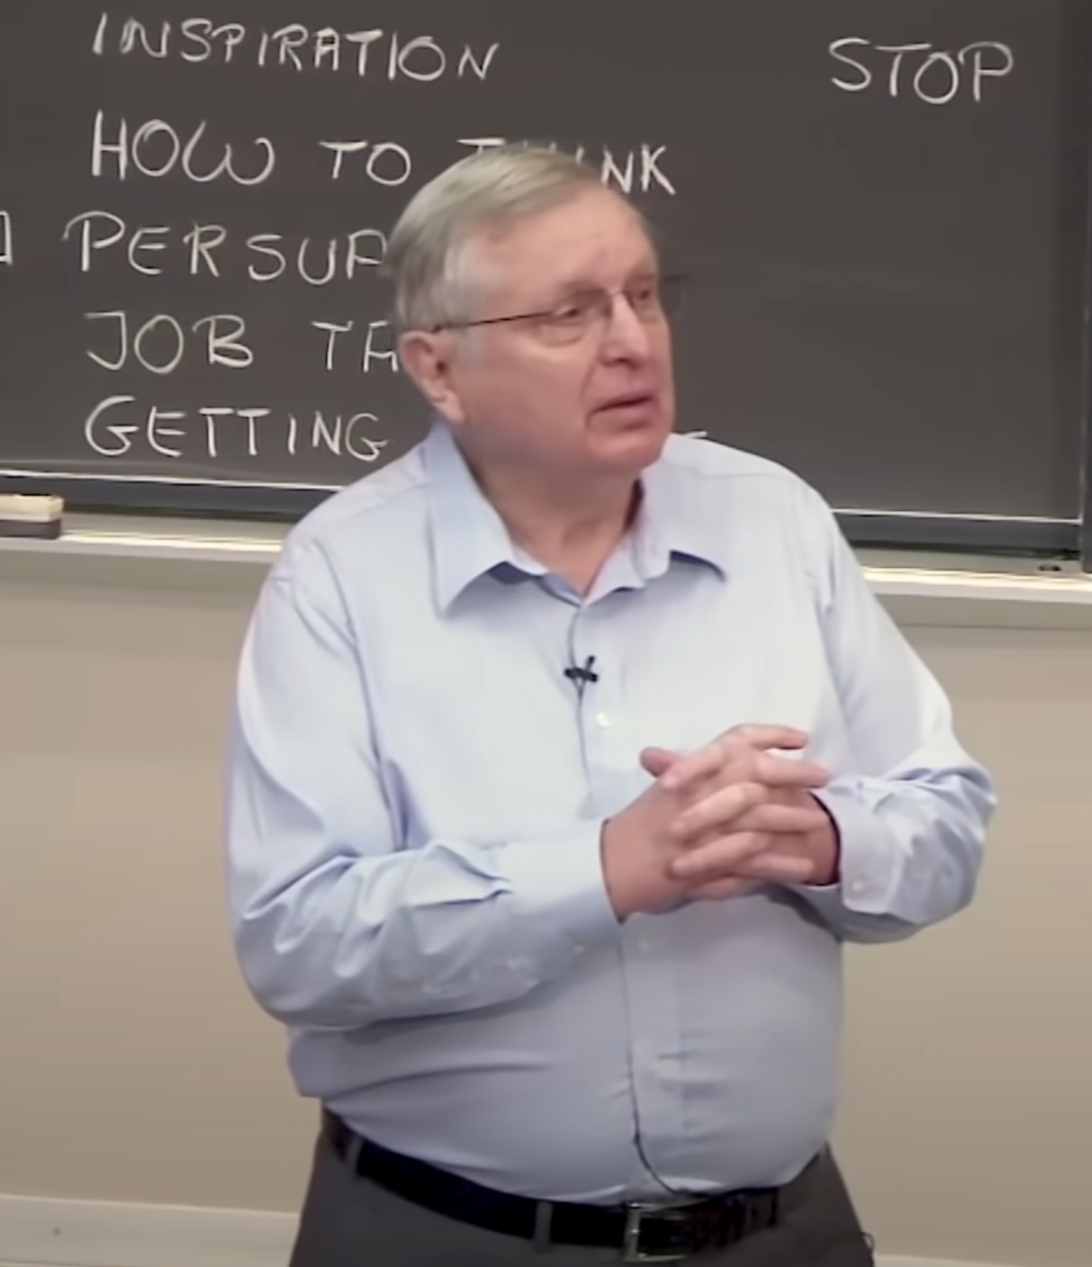
Background
I took his AI course as freshman
And first heard this talk in 1970s
Patrick died soon after the version you listened to
Heavy breathing / Low energy
Try to enjoy yourself
Audience is like a dog
If you feel good → they feel good
If you show fear → they will bite
Find your own voice
Patrick has a formula that works for him (a bit too much for me)
Your mileage may vary
https://www.youtube.com/watch?v=lE3KNOz6uo8
https://www.youtube.com/watch?v=Unzc731iCUY

Slide 9
Cathy’s Timeline: Talk (30) + Questions (30) https://www.youtube.com/watch?v=TQHs8SA1qpk
Negative Criticism: 32 minutes
Personal Background: 0-4
Loves math (because it is true)
Disillusion (5)
Algorithm = Data + Loss Function
Success for whom (8)
Audience for Book (public): (9)
Job/School/Loan/Insurance/Jail (10)
Three Examples (not 12!)
Teaching (11-20)
Employment (20-25)
Police Practices (25-32)
Constructive Conclusion: (32-33)
do no harm, oath, method to audit, transparency
Criticism: downer (too negative)
more problems than solutions

Slide 10
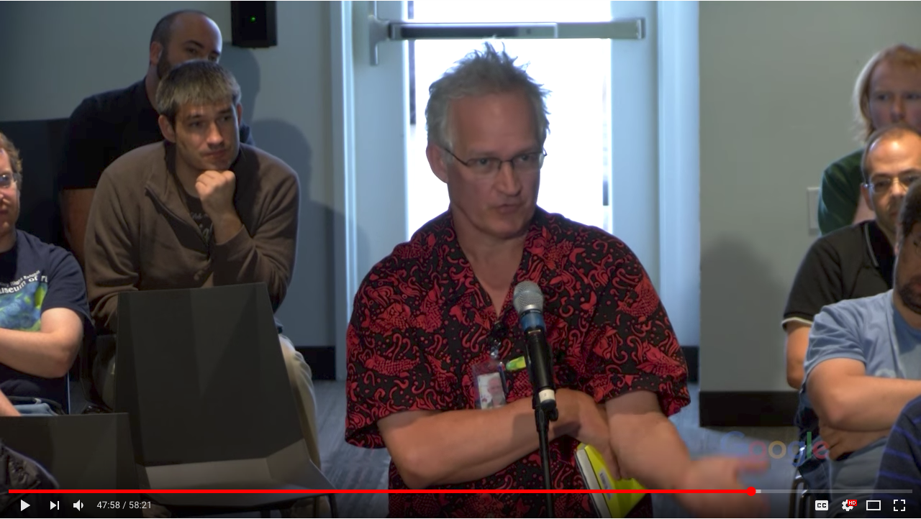
What is the ask? Purpose of Talk?
Propose: Book tour
Ask: Please buy her book
Different talks for different audiences
Book → General Public
Google ≠ General Public

Slide 11
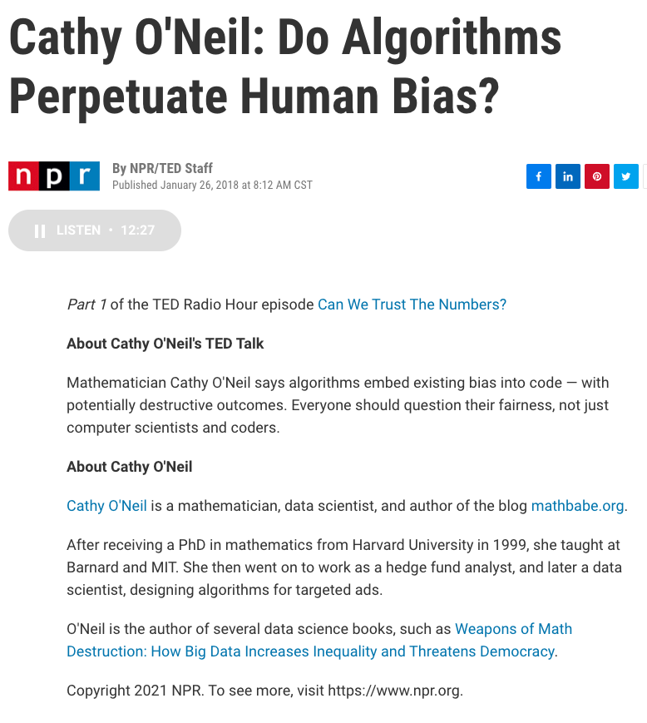
Engage the Audience
More Challenging Audience
More Sympathetic Audience

Slide 12
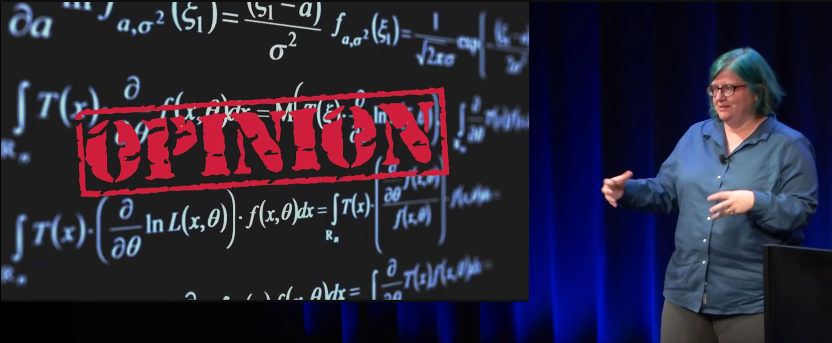
How does she start?
Establish a bridge with the audience
Some speakers start by pulling rank,
But her approach may be more affective (bond with audience)
Personal Background: 0-4 minutes
Loves math (because it is true)
Disillusion (5 minutes)

Slide 13
Patrick’s 5 Minute Rule: Create the problem and solve it in 5 minutes

Slide 14
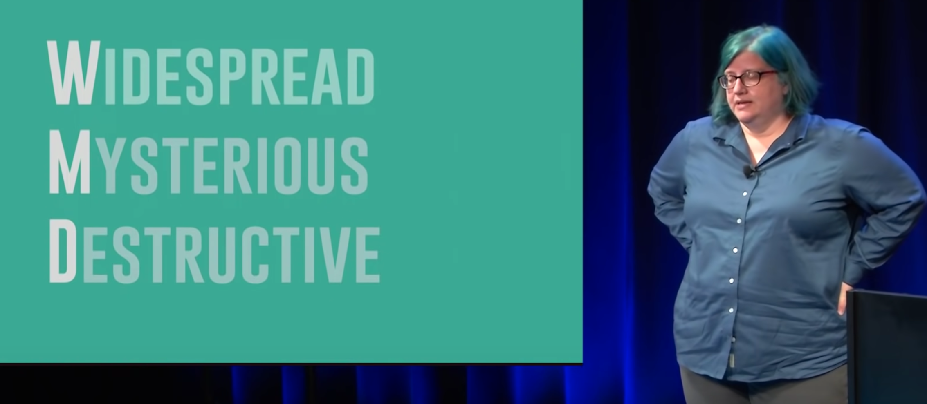
Memorable: WMD Weapons of Math (Mass) Destruction

Slide 15
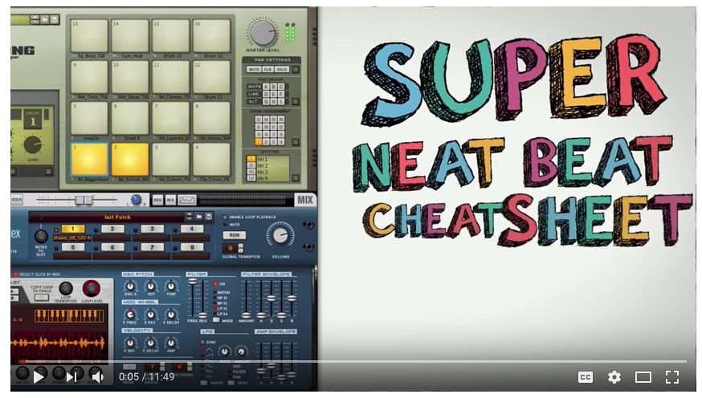
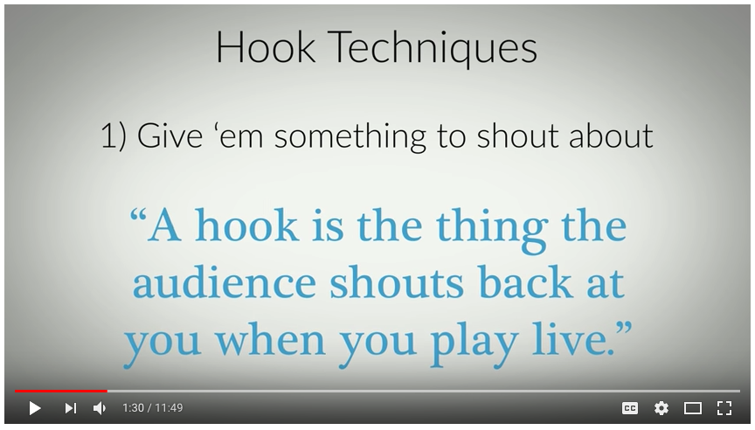
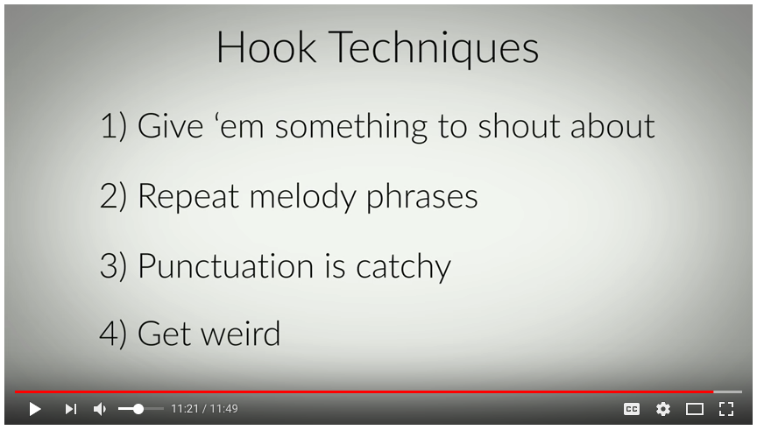
Hooks https://www.youtube.com/watch?v=CpRkoZs1Bvc

Slide 16
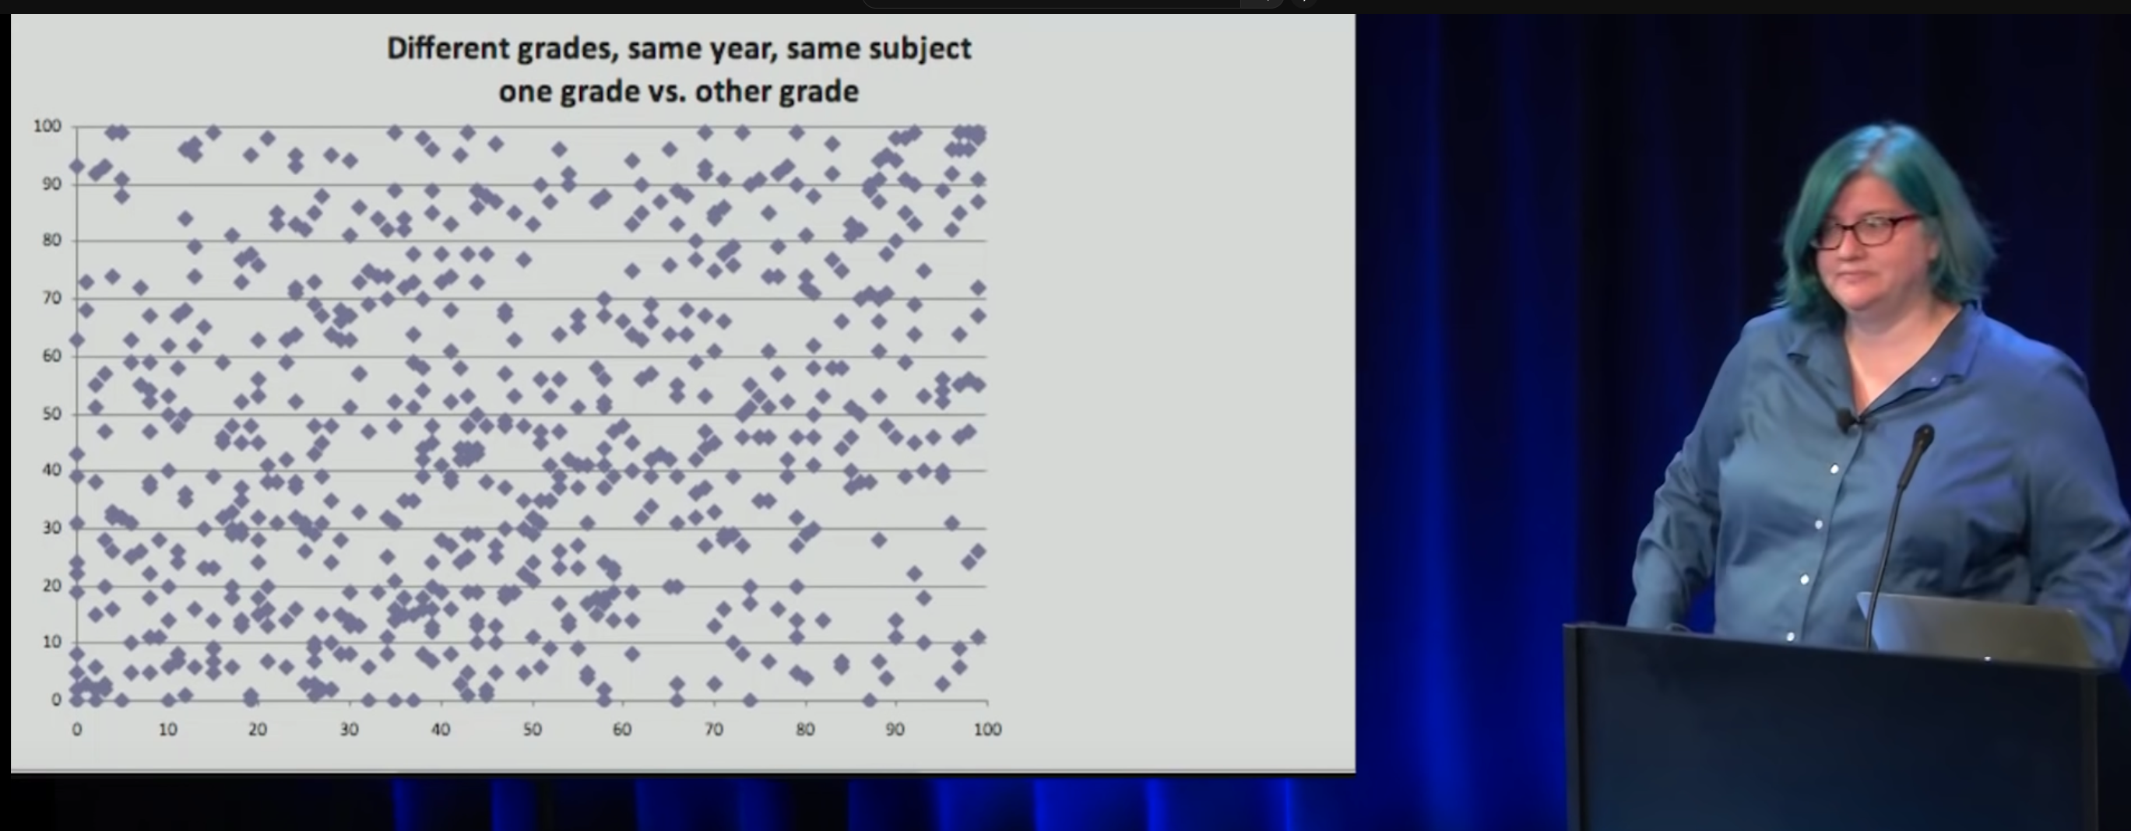
Punch Line: Little Correlation → Laughter

Slide 17

How does she end? Ans: Constructive suggestions

Slide 18
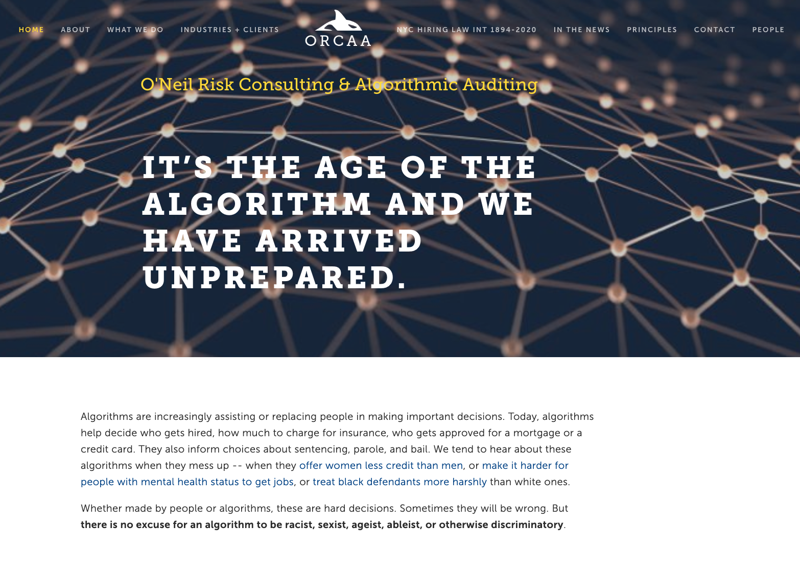
What is she doing now?

Slide 19
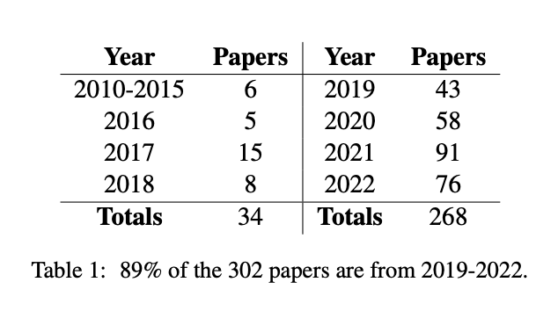
Survey of Papers on Bias in ACL Anthology
WMD

Slide 20
Do’s and Don’ts (from a class 5 years ago)
You guys did
You guys (mostly) didn’t
Agree with Cathy
Profit ≠ Fairness
Lack of transparency
Pivot from her WMD story to topics we’ve discussed recently
Word embeddings
Deep Nets
Adversarial Attacks
Speech recognition
How to get citations
Some mentioned specifics
loans, teaching, college admissions…
Citations ranged from 107 to 170
Not yet seminal (more recent; less cited)
Disagree with Cathy
Get defensive / Attack her
Cite the same references
Many of these issues have been raised before
Why is Cathy’s work being noticed (more than others)
Offer constructive suggestions
Sunlight
Democracy
Media Pushback (Social + Traditional)
Peer pressure, affirmative action, PC, epidemiology, quotas
Regulation: FDA for algorithms
Run studies to prove safe & effective
Unwind rankings-fuelled feedback loop generates an unreasonable number of college applications

Slide 21
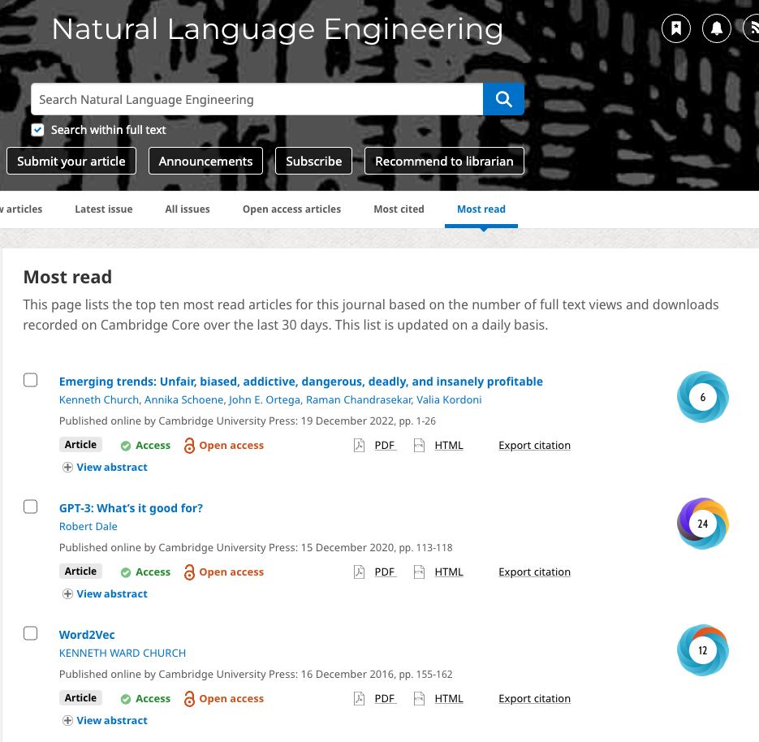
Unfair, biased, addictive, dangerous, deadly, and insanely profitable
https://www.cambridge.org/core/journals/natural-language-engineering/most-read
Responsible AI: Need to address both Risks 1.0 & 2.0
Risks 1.0:
Unfair and biased
Risks 2.0:
Addictive, Dangerous and Deadly
Root cause:
Toxicity is insanely profitable
Trafficking in misinformation → more engagement → profit

Slide 22
Panel Presentation on Bias

Slide 23
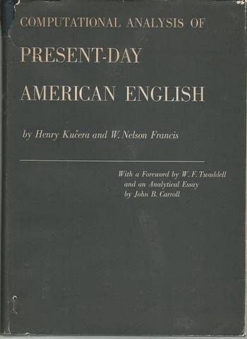
Bias and Balanced Corpora
Super-important in Lexicography
PMI (Church & Hanks, 1990)
Should a dictionary be
Prescriptive (e.g., RP, King’s English)
Descriptive (e.g., a sample full of warts)
Debiasing a corpus → Prescriptive
Real corpora contain 4-letter words
(and much worse)
Social media → Unrepresentative
(algorithm → toxicity)

Slide 24
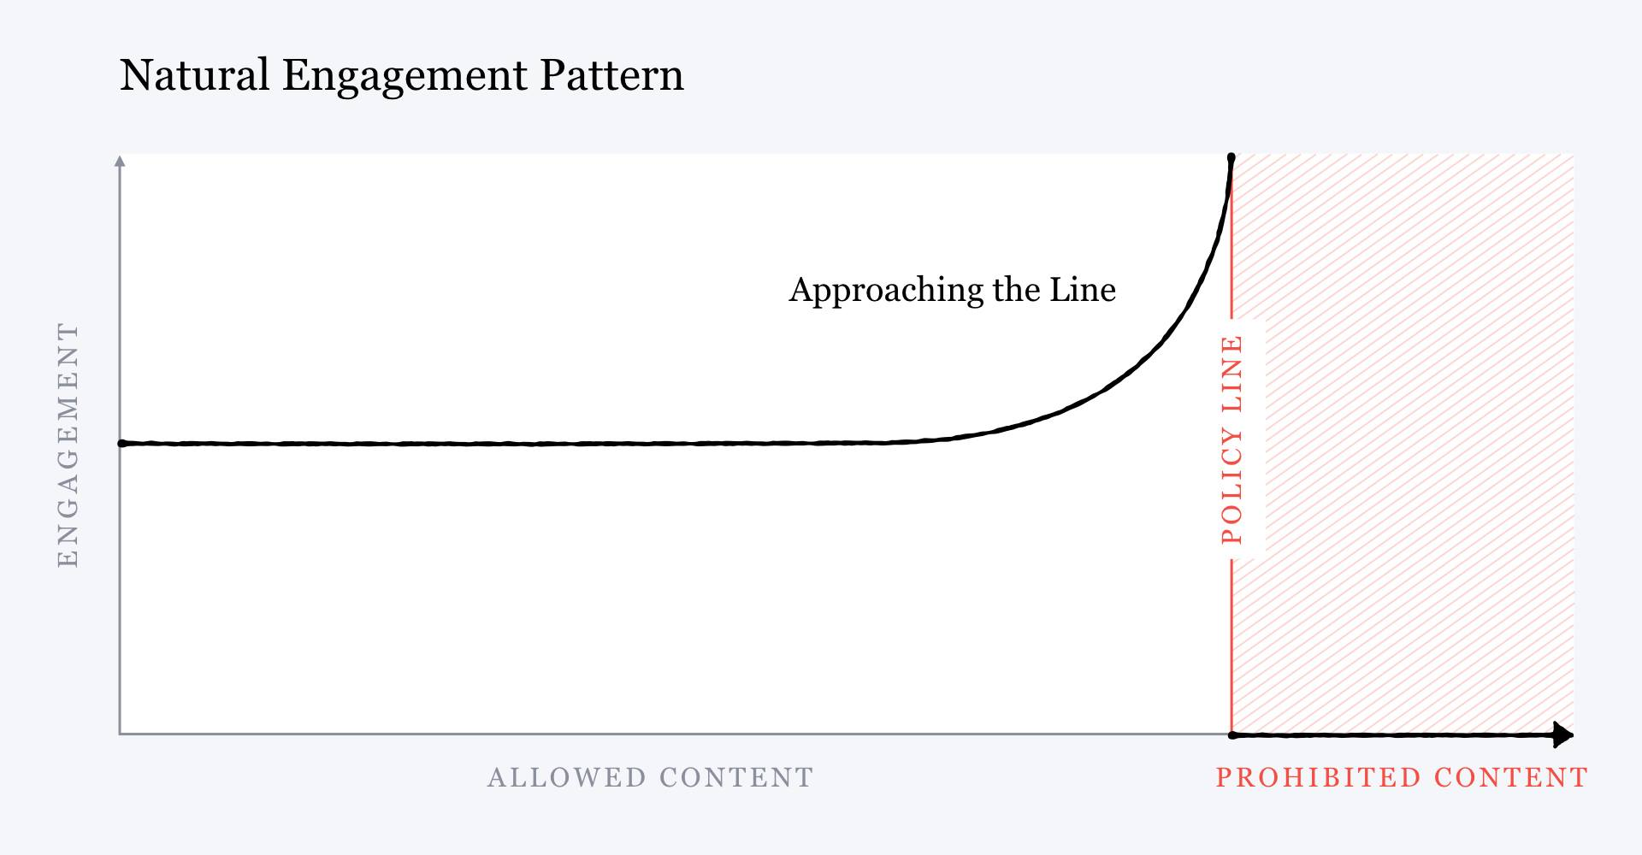
A Blueprint for Content Governance and Enforcement Mark Zuckerberg https://www.facebook.com/notes/751449002072082/
Smothers brothers get cancelled

Slide 25
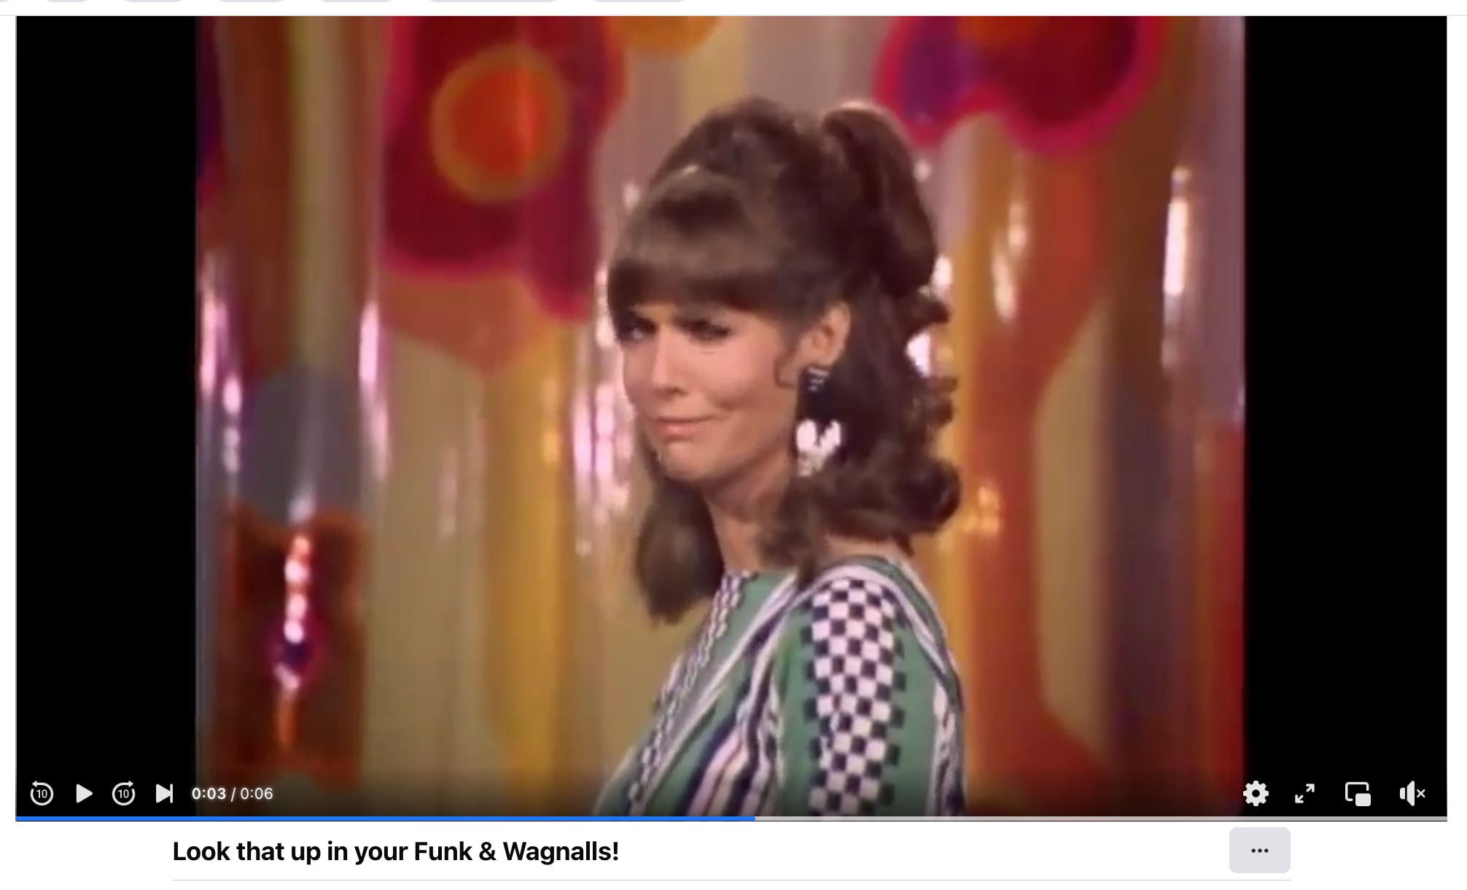
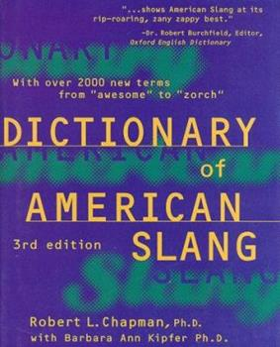

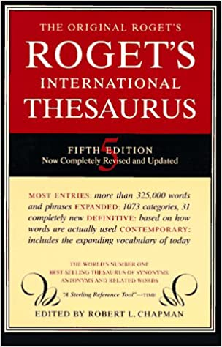
Chapman (Chap): Blacklisting, Censorship
Taboo Content is Engaging (Social Media)
Laugh-In
Sock it to me!
Here come de Judge!
You bet your sweet bippy!
Look that up in your Funk and Wagnalls!
Laugh-In was breaking rules
7-words you can’t say on TV
``Funk’’ sounds like one of them
Ironic
Chap was blacklisted
He is also an expert on ``slang’’
For field work, he would listen to right-wing talk radio
``guilty pleasure’’: shocking (and engaging)
Their language is not like our language
https://www.facebook.com/watch/?v=10156729609852845
Excellent coverage of taboo language
Excellent coverage of taboo language

Slide 26
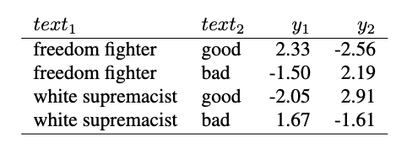
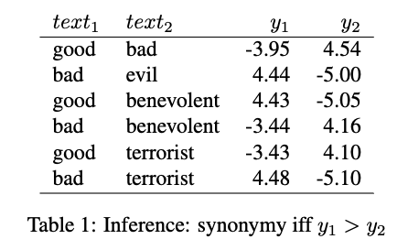
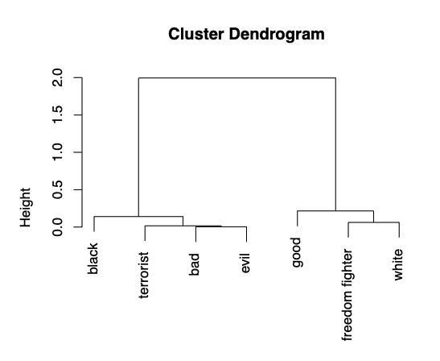
Biases are everywhere
Training on Lexical Resources
Church et al, LREC-2022

Slide 27
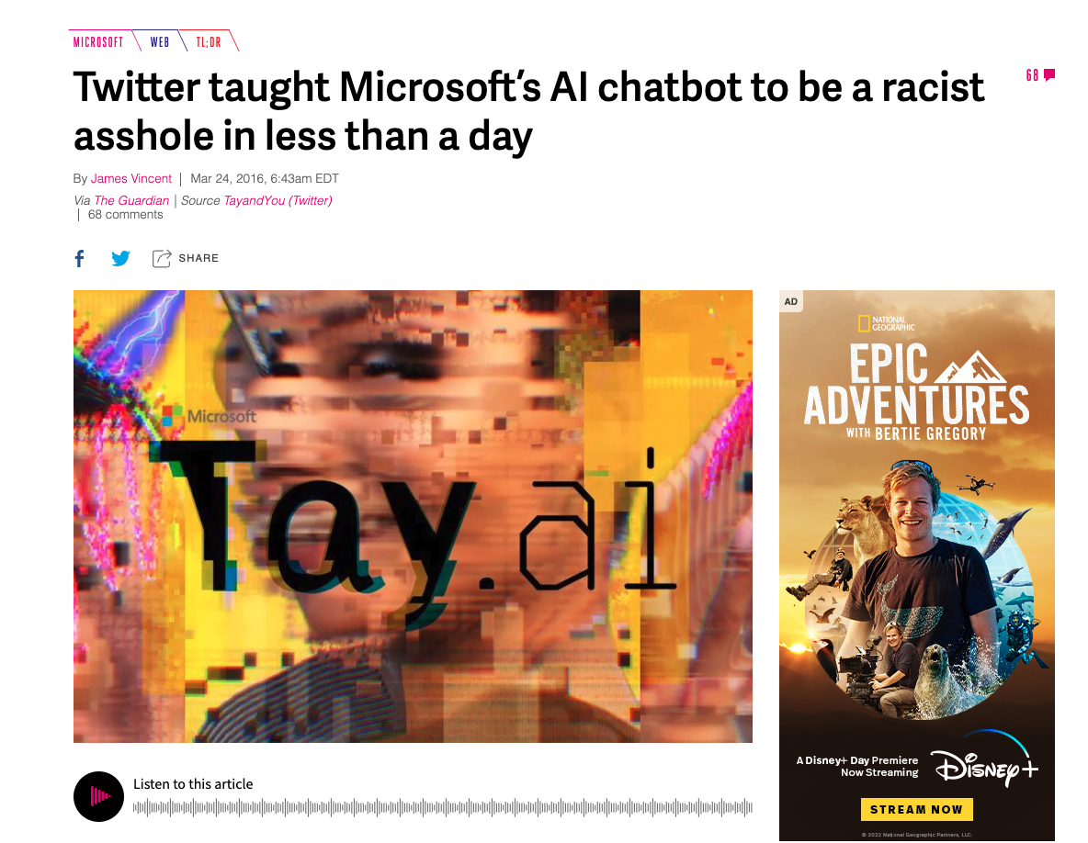
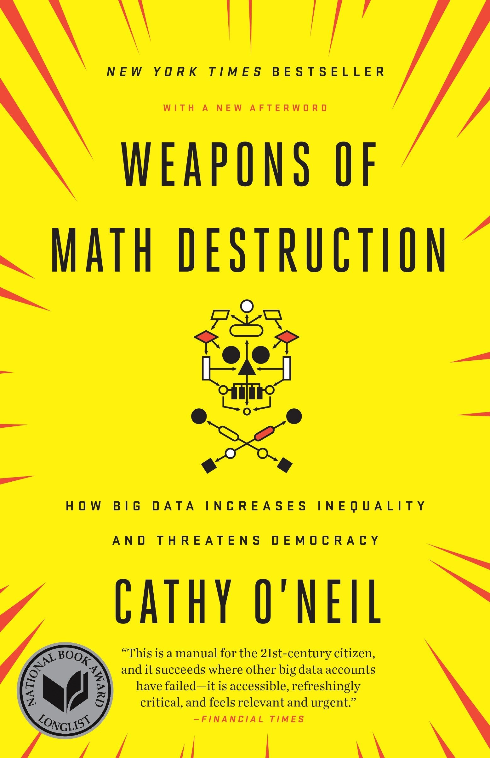
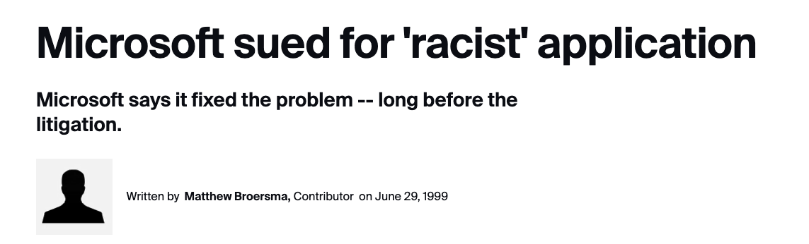
Taboo Content Risk 1.0 (5 years ago) Product gets canceled
Stupidity: To err is human…
Spelling Correction
Obama → Osama
Bots:
Kids chat with Santa
Snow → I like drugs too…

Slide 28
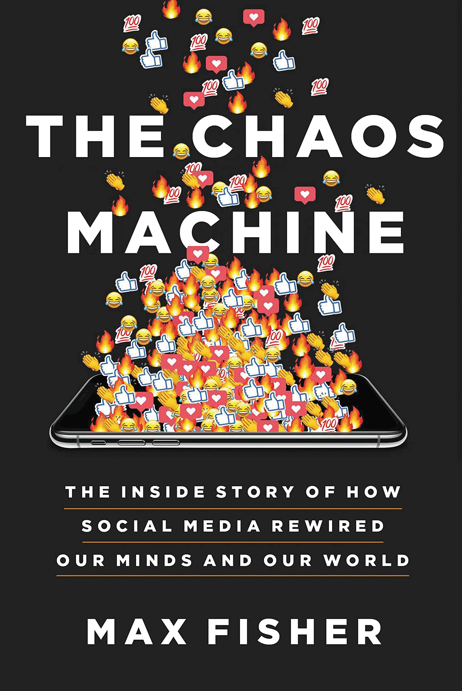
Are we losing ground??? Are we at fault???
2016
2022
Risks 1.0: (work in progress)
Unfair, Biased
Risks 2.0: (bigger than us)
Addictive, Dangerous, Deadly and Insanely Profitable
Root causes:
ML + Social Media → Addiction
Max Engagement → Dangerous
Insanely profitable:
Companies & Countries
Long book, but no mention of our efforts to address Risk 1.0

Slide 29
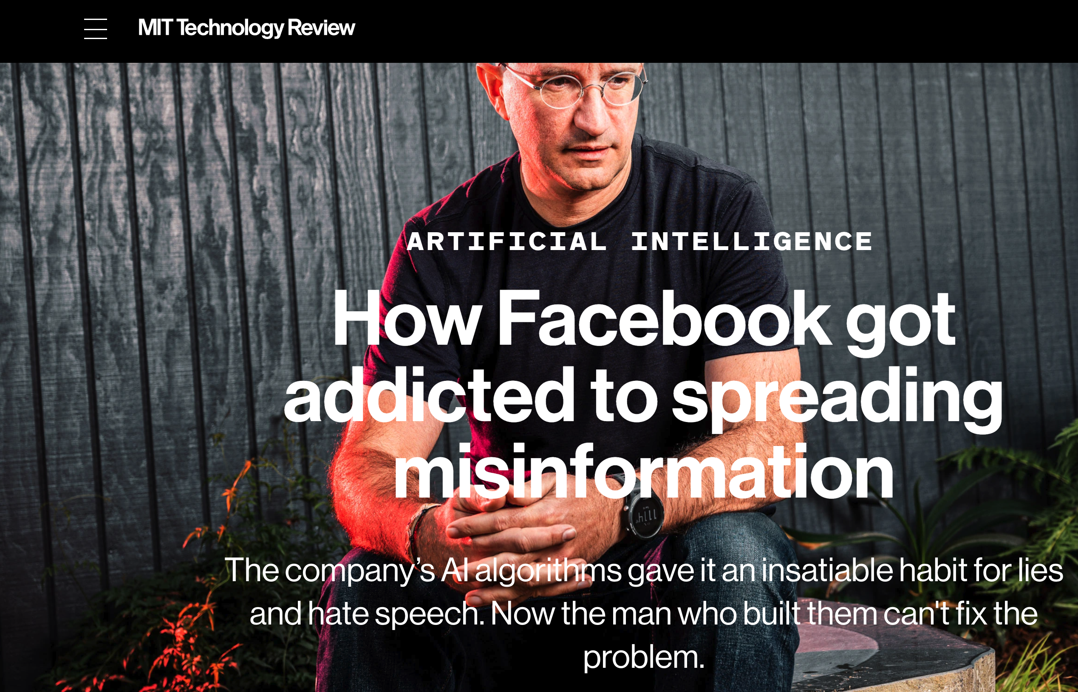
Reporter wanted to talk about 2.0 risks; Accused Facebook of pivoting to 1.0 risks https://www.technologyreview.com/2021/03/11/1020600/facebook-responsible-ai-misinformation/

Slide 30
Pivot Criticism
But Entin and Quiñonero had a different agenda.
Each time I tried to bring up these topics [2.0 risks],
my requests to speak about them were dropped or redirected.
They only wanted to discuss [1.0 risks],
the Responsible AI team’s plan to tackle one specific kind of problem:
AI bias, in which algorithms discriminate against particular user groups.
An example would be an ad-targeting algorithm
that shows certain job or housing opportunities
to white people but not to minorities.
https://www.technologyreview.com/2021/03/11/1020600/facebook-responsible-ai-misinformation/

Slide 31
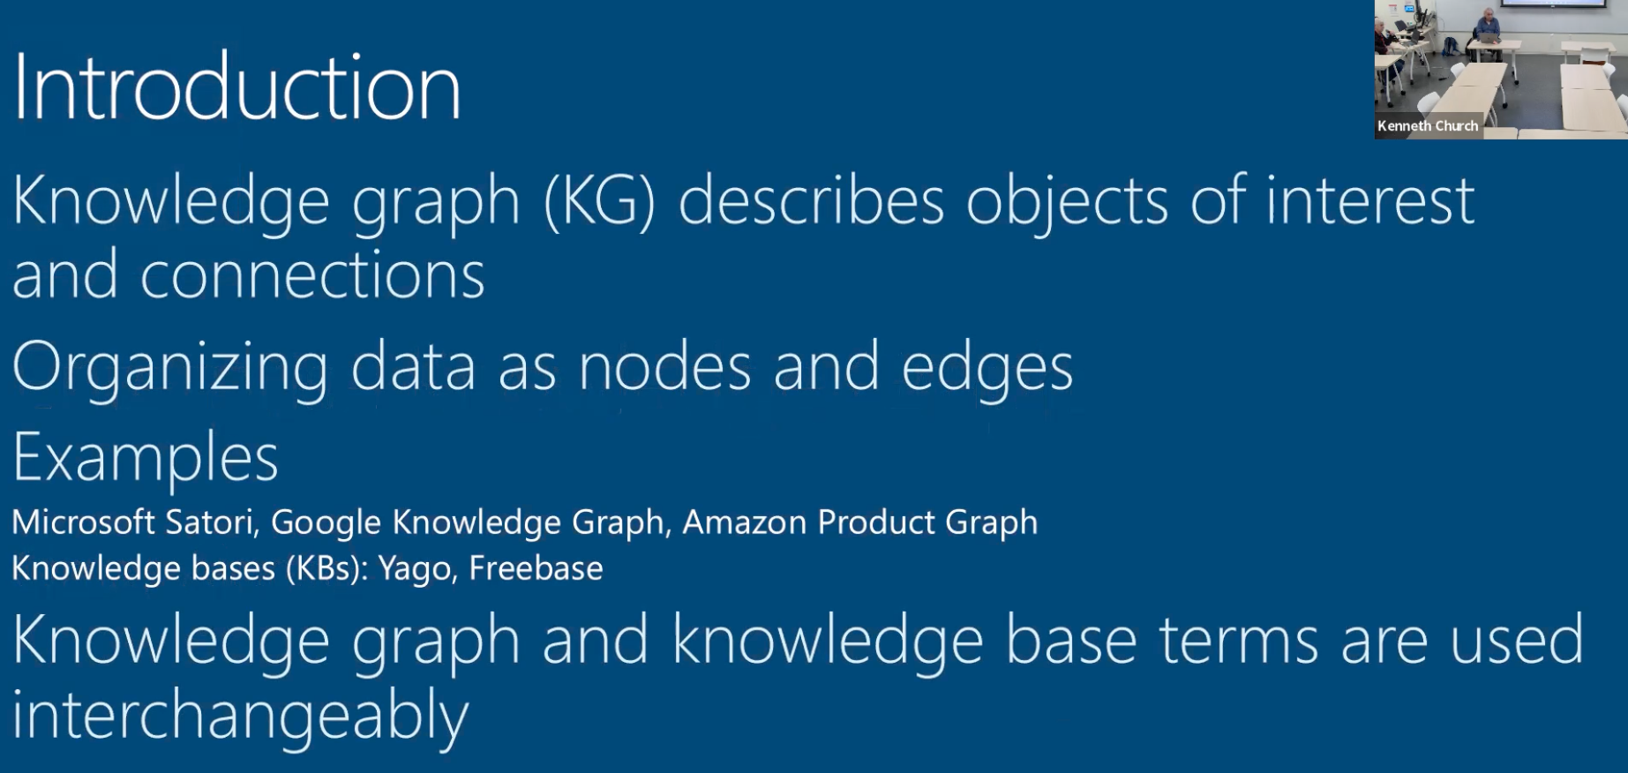
How did Omar start? We should be working on KG; no ask/promise

Slide 32
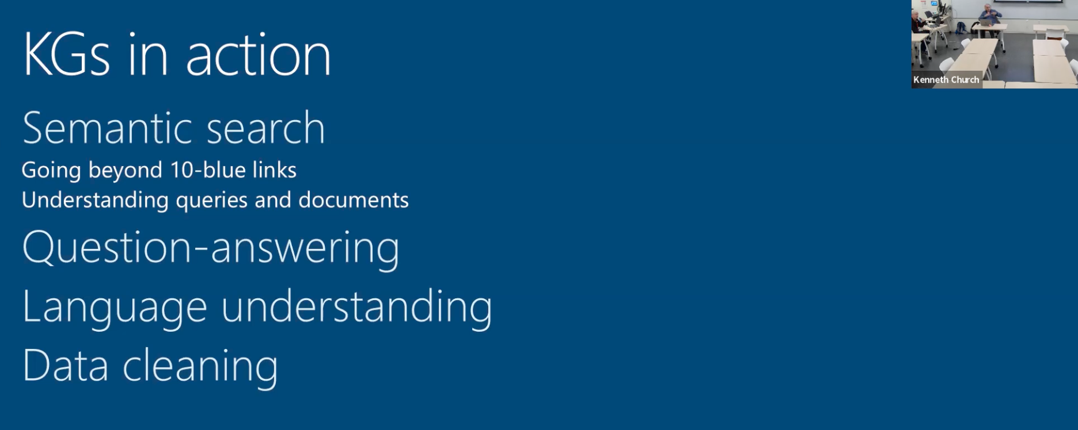
Patrick’s 5 Minute Rule: Still not clear where we are going

Slide 33
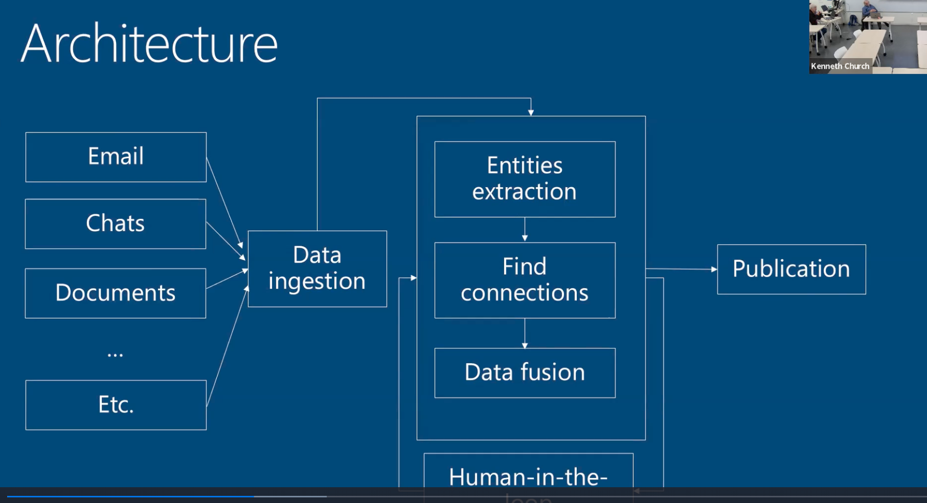
Patrick’s Rule about 1 complicated slide

Slide 34
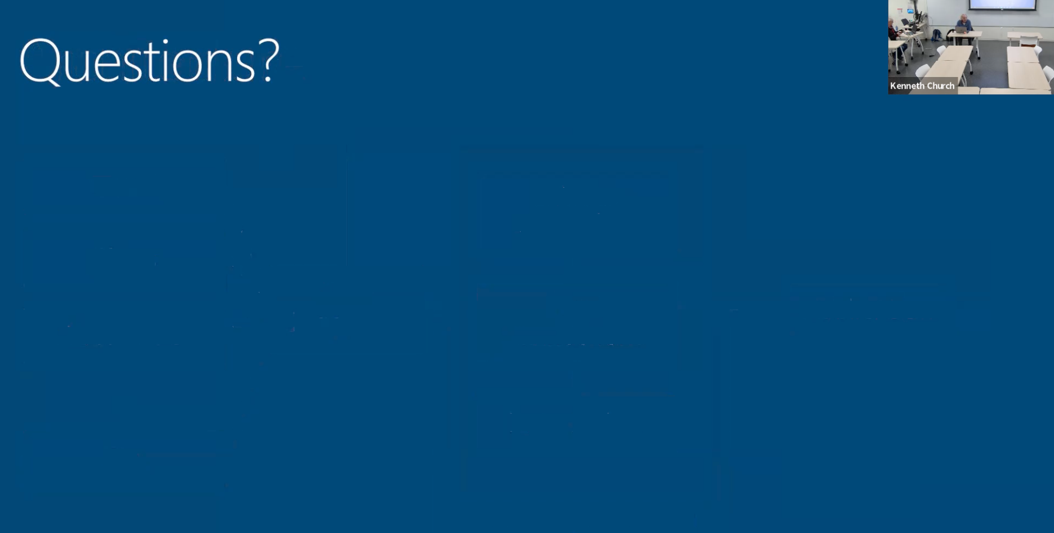
How did Omar end?

Slide 35
Discussion: An effective talk will anticipate these issues
What did he/she say?
If audience cannot summarize 30 minute talk in 30 seconds,
then it doesn’t matter what they said
What is the ask?
Ans: 1.5 months of engineer’s time
Do-able & Worth doing
Promise / Delivery:
MVP (Minimum Viable Product)
Budget / Timeline / Evaluation / Roadmap
Related work: Cyc, Wordnet
Metrics of success: downloads, engagement, citations
Under-promise and over-deliver
Credibility of team
Different paths to successful career
Sales / Delivery

Slide 36
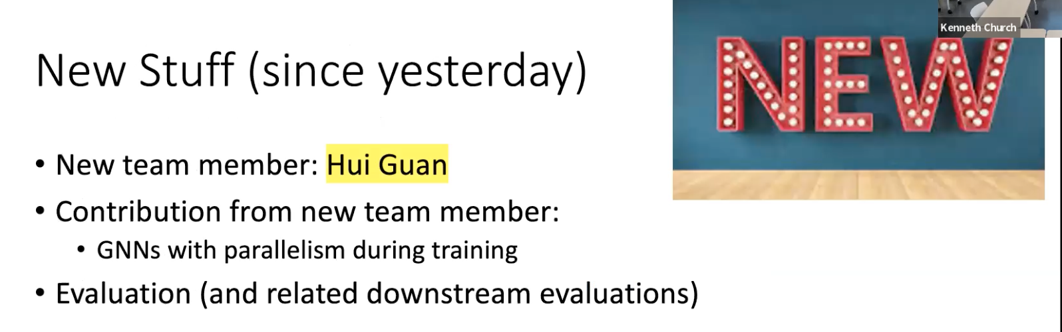
How did Ken start? What’s new since the previous versions of this talk

Slide 37
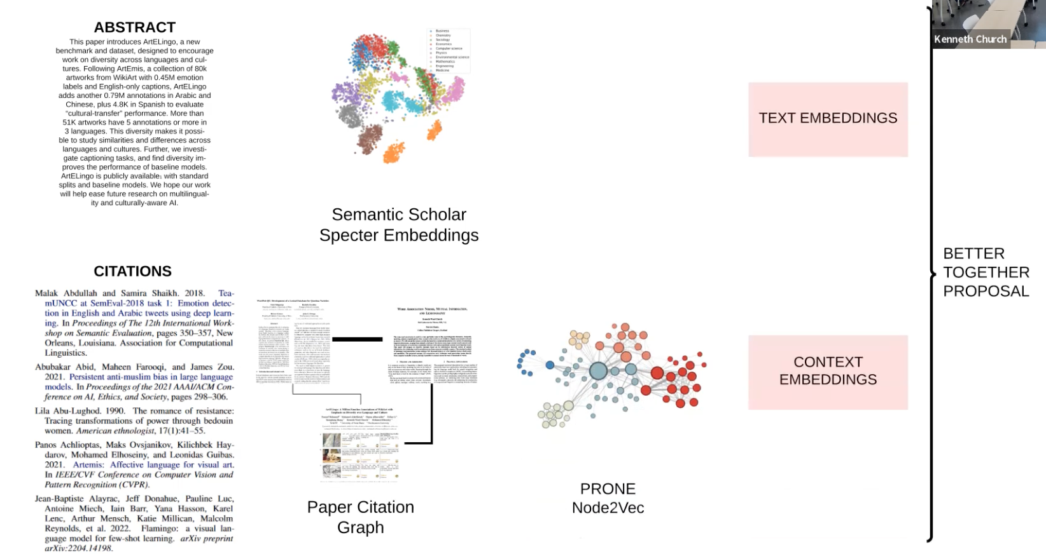
Where are we after 5 minutes? (Patrick’s 1 complicated slide)

Slide 38
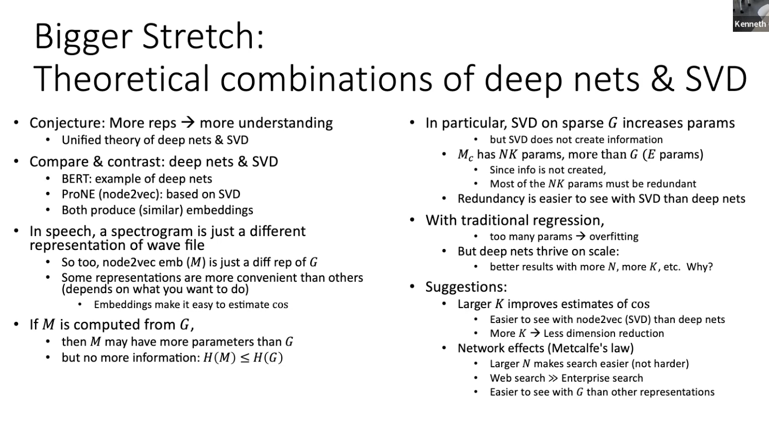
How did we end?

Slide 39
Discussion
It is all over the place
Systems, Information Retrieval, etc.
Hybrid of merged projects:
looks chaotic because it is
Embeddings can represent almost anything
Doesn’t mean much
Make it very obvious that an embedding is just a spectral representation of almost everything
Evaluation: opportunity for improvement

